Slide 1
School Supply management system
Developed by: group 7

Slide 2
Overview
As the shop grows or the supply becomes bigger it needs a good inventory system. These tasks can be done easily and fast. Organizing items as a part of the system is much more efficient than actually organizing them. Having trouble recounting the whole set of items is easy if done using a management system. Having a Management System in a Supply shop can make the job easier and more accurate. It can also have the feature to compute the sales in your shop daily, weekly, monthly, quarterly, and even yearly. The inventory system was cheaper than a staff that does the inventory manually.
Notes:
Dennyel

Slide 3
General objective
To develop an Inventory System that will help in monitoring the stocks of the products to be accurate and organized. Also, that will help them to record their sales and the stocks easier
Specific Objectives
● To develop a system that will organize the record of all the information.
● To develop a system that will compute the sales and record transaction for product purchased and the number available in store.
● To develop a system that will generate sales reports.
● To develop a system that will record the stocks of each product/s.
● To develop a system that will provide accurate recording and updating of product information.
Notes:
Dennyel

Slide 4
Scope
Managing supply is not easy to perform. Depending to the system capabilities, managing supply of a store or corporation ca become easy. Moreover, the computerized system will help to ease and minimize the work of the employees.
The School Supply Management System will cover the following features/capabilities:
Add, Update, Search, and Delete the Customer Information
Add, Update, Search, and Delete the Product Information
Process orders/payments of a customer.
Generates summary of reports needed.
Capable to search datas.
Notes:
Anna

Slide 5
Limitations
Not all systems are perfectly made and there are limitations that all systems have. The first limitation of our system is that it has no login feature. Second, the system cannot hold much data because of the limited capacity. Third, bugs and errors can occur if the system does not get new updates. The last is the user of the system who does not know about computers and the system.
Notes:
Anna

Slide 6
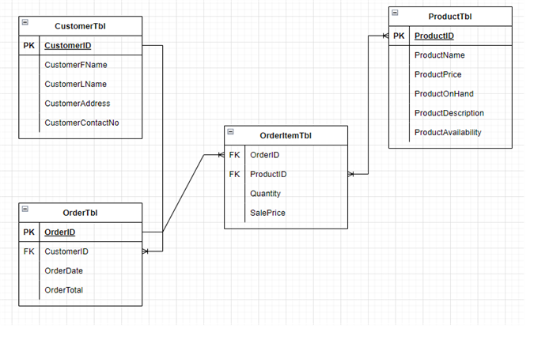
Database Design
Notes:
denver

Slide 7
Programming Language
The School Supply Management System will be developed using Python as a programming language.
Python is a high-level, interpreted, general-purpose programming language. Its design philosophy emphasizes code readability with the use of significant indentation. Python is dynamically-typed and garbage-collected.
Notes:
denver

Slide 8
Database System
The datas of the system will be managed, stored, and updated by SQLite.
SQLite is a database engine written in the C language. It is not a standalone app; rather, it is a library that software developers embed in their apps. As such, it belongs to the family of embedded databases.
Notes:
denver

Slide 9
User Interface Builder
The user interface of the School Supply Management System will be built using Qt Designer.
Qt Designer is a tool for quickly building graphical user interfaces with widgets from the Qt GUI framework. It gives you a simple drag-and-drop interface for laying out components such as buttons, text fields, combo boxes and more.
Notes:
denver

Slide 10
Sql commands
INSERT INTO
UPDATE
DELETE
CREATE TABLE
WHERE
SUM()
ORDER BY
LIMIT
ASC
SELECT
CREATE VIEW
LIKE

Slide 11
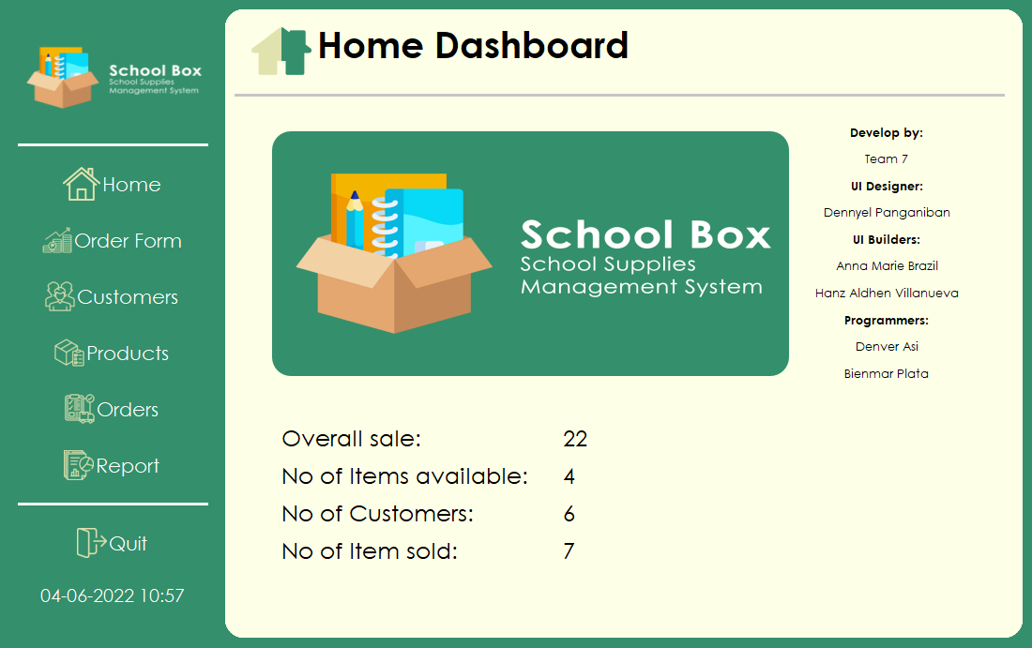
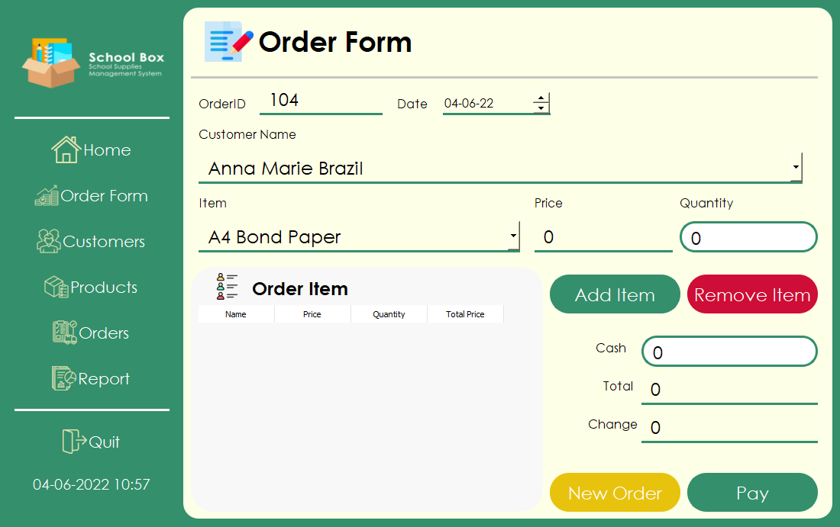
User Interface Design
Notes:
Hanz

Slide 12
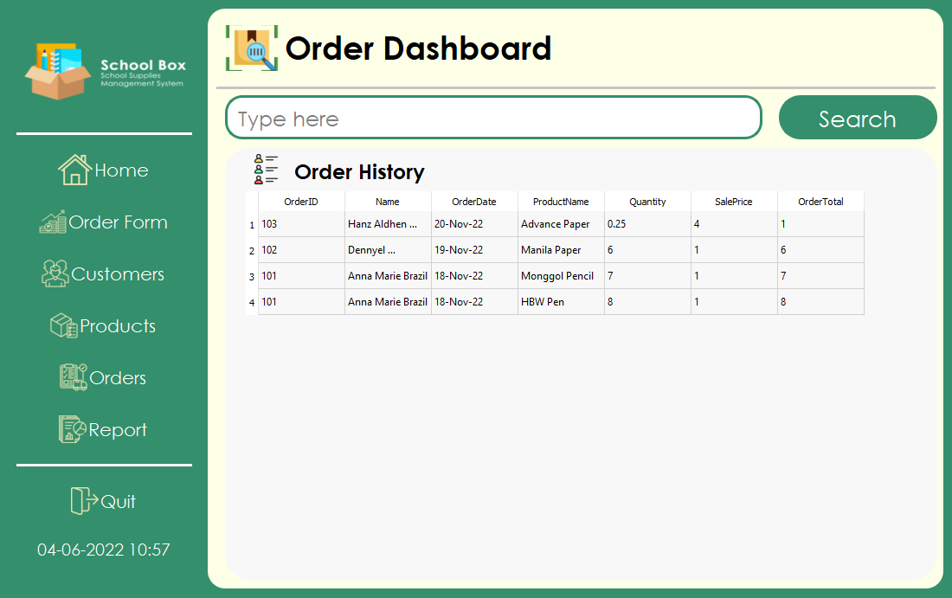
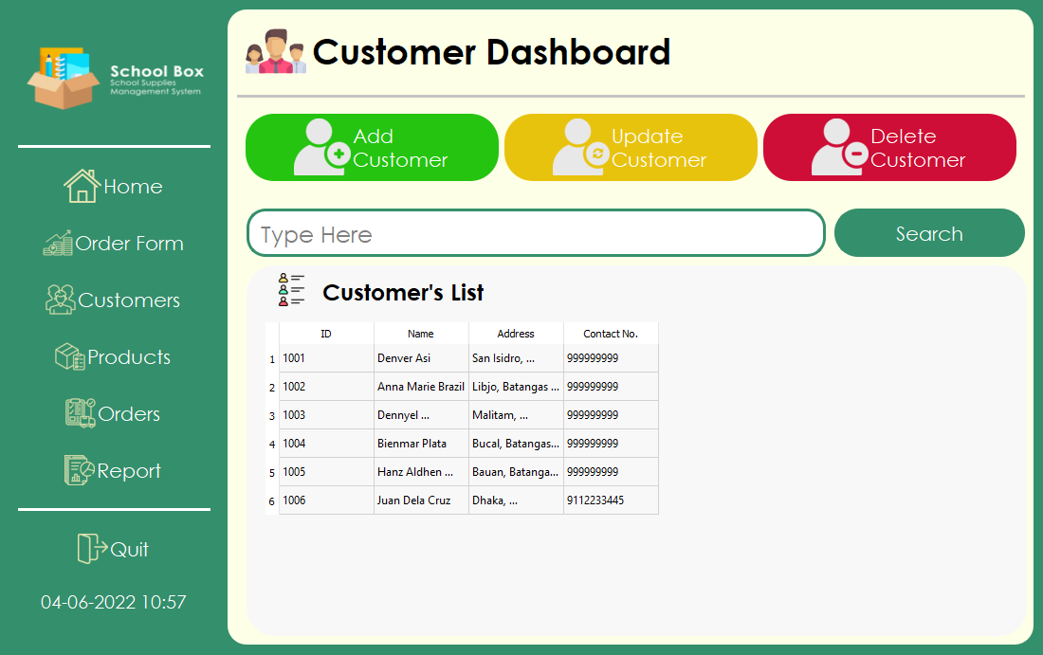
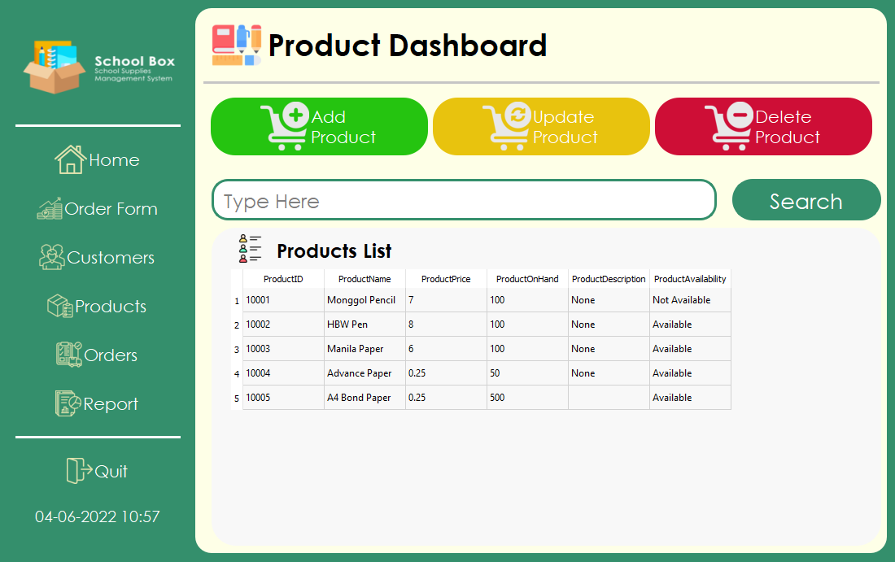
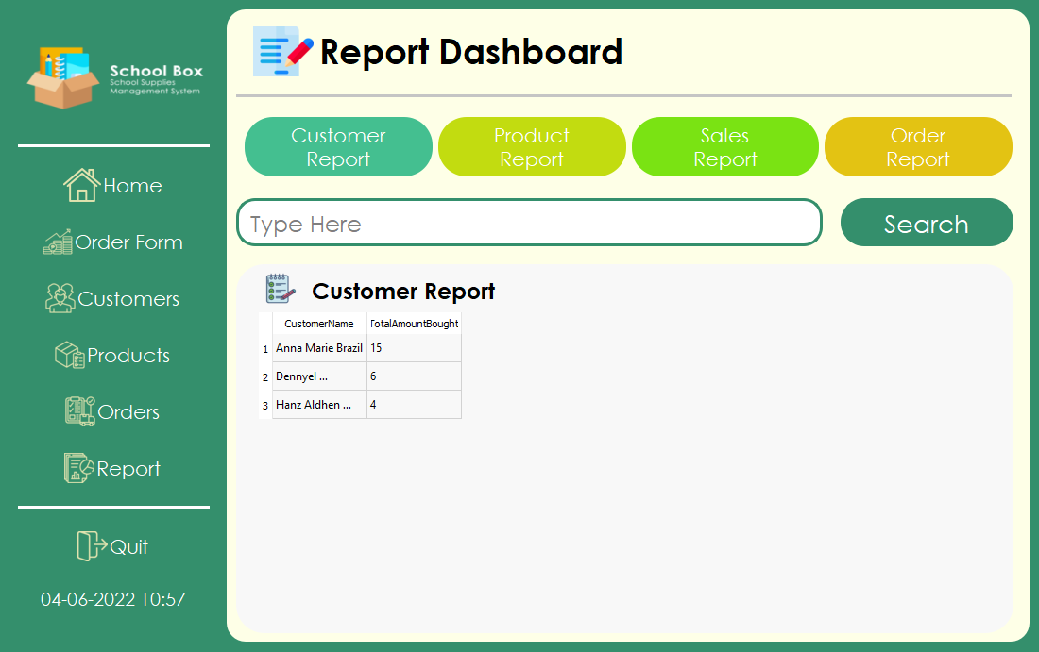
User Interface Design
Notes:
haz

Slide 13
User Interface Design
Notes:
hana

Slide 14
Demonstration

